Slide 1
BIOM 200 Module 1: Introduction to Bioinformatics RNA-sequencing and ATAC-seq analysis
09/26/2018

Slide 2
Outline
Intro to RNA-seq
Processing pipeline and workflow
Later: intro to Triton Shared Computing Cluster (TSCC)

Slide 3
RNA-seq Pipeline
RNA Isolation and Fragmentation
Library Preparation
Sequencing
Genomic Alignment of Sequencing Reads

Slide 4
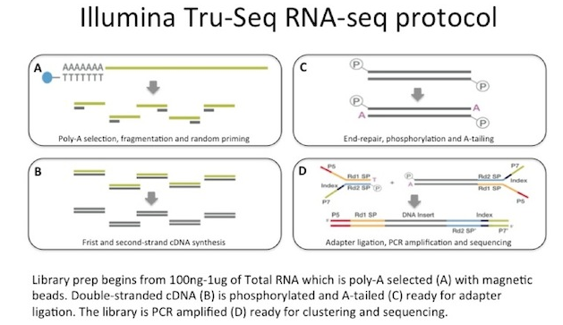
General Library Preparation

Slide 5
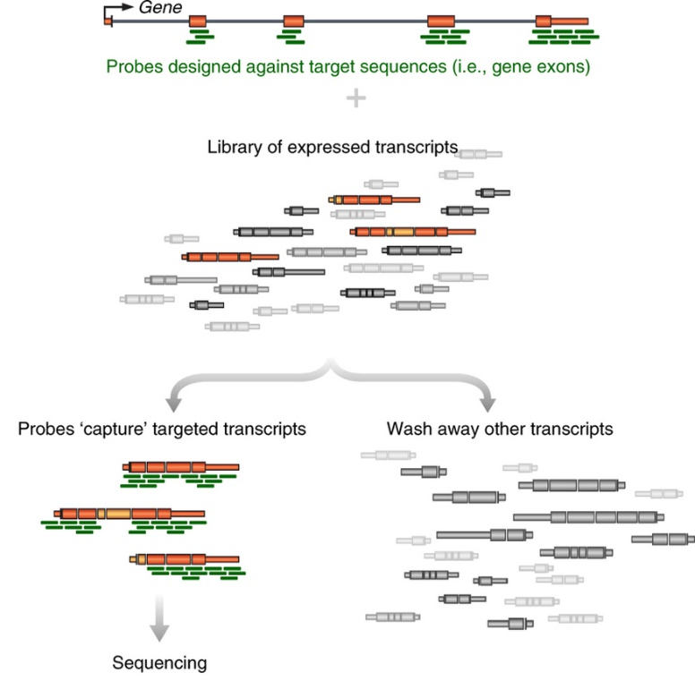
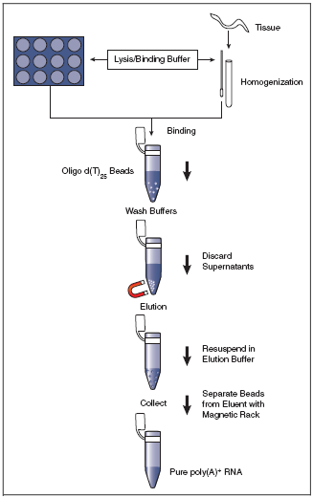
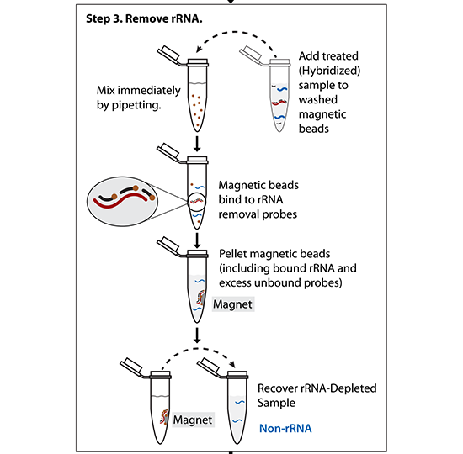
Step 1: What RNA do you want to profile?
mRNA only -> PolyA selection
rRNA-depleted RNAs -> rRNA negative selection
Specific RNAs -> targeted enrichment
(All mRNAs are polyadenylated at the 3’ end – can use d(T)₂₅ beads to select)
(Probes matching rRNA are used to pull-out rRNA molecules)
(Other methods – hybridize targeted DNA oligos + RNAseH treat)

Slide 6
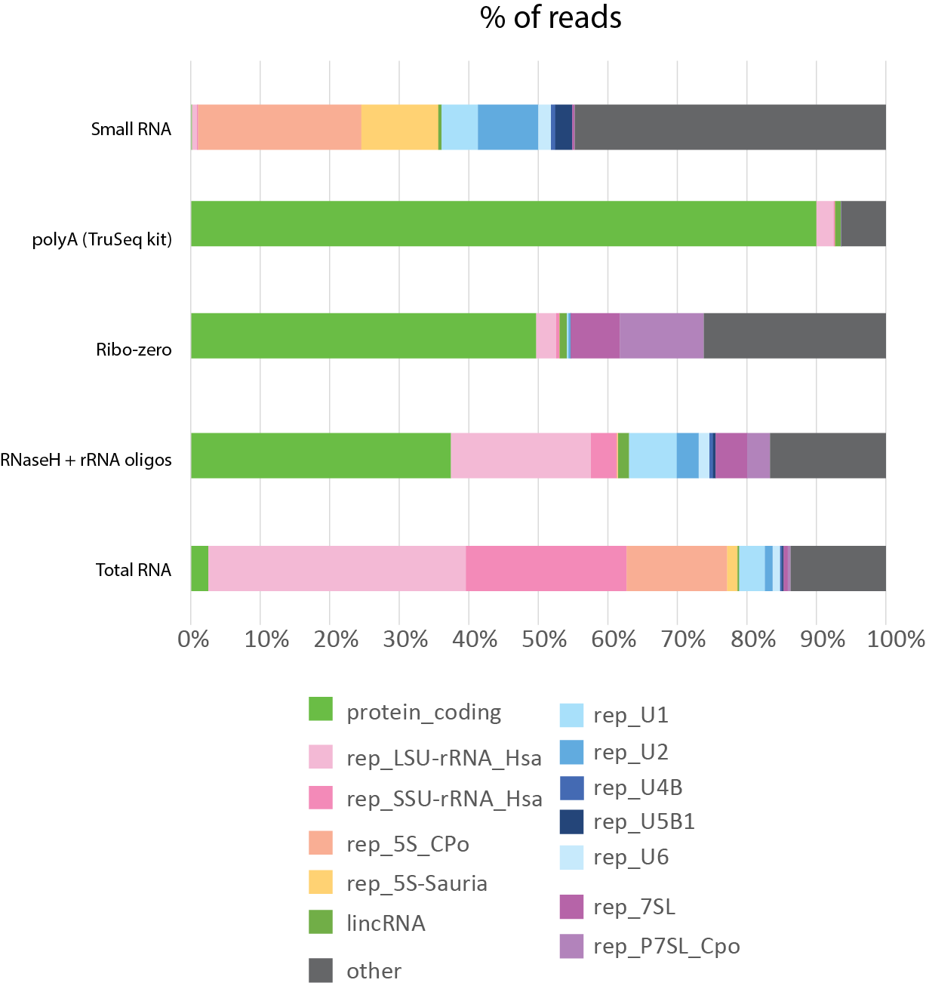
Step 1: What RNA do you want to profile?
Preparation method greatly impacts the over profile of your library

Slide 7
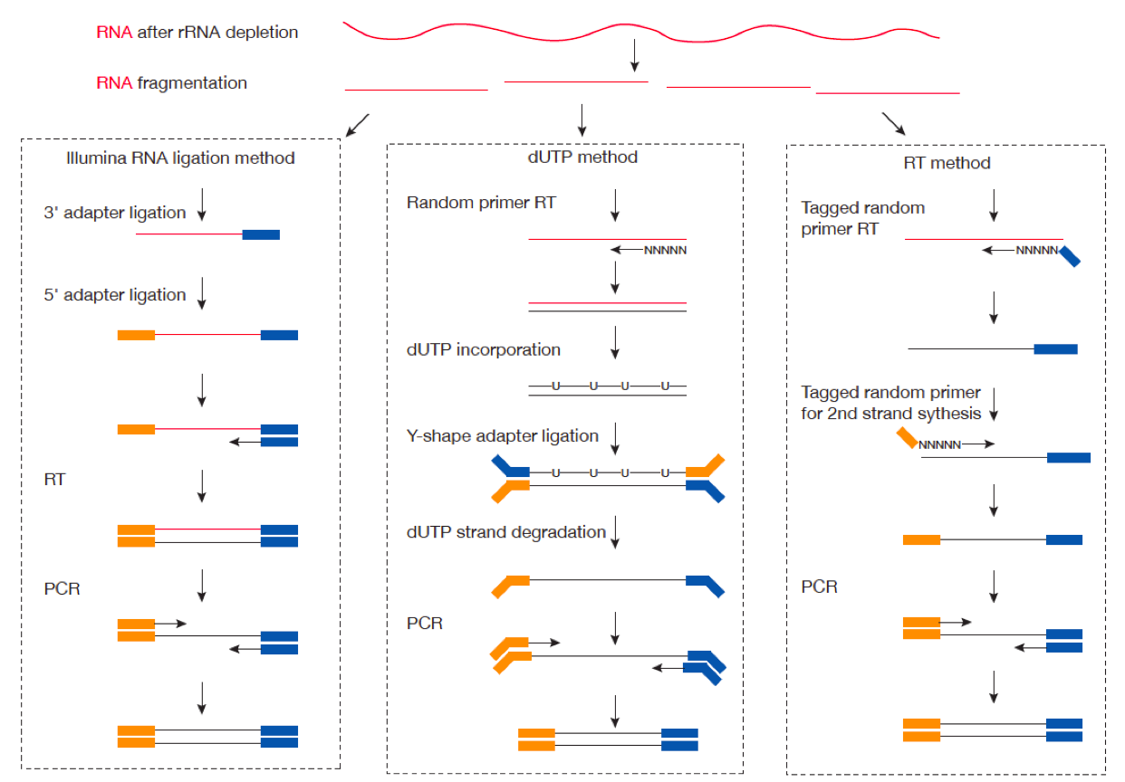
Step 2: How do you preserve strand information throughout RT?

Slide 8
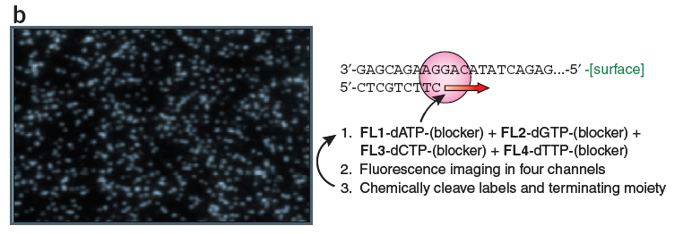
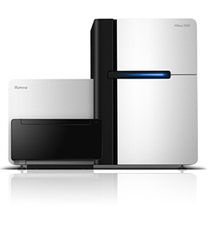
Sequencing by synthesis: HiSeq 2500 (Illumina)
Shendure & Lee, Nat. Biotech. 2008
Can do 50bp to 250bp single-end or paired-end reads
~300 million reads per lane x (2 or 8) lanes
4-8 days run time
200 billion bp output each run
Notes:
8

Slide 9
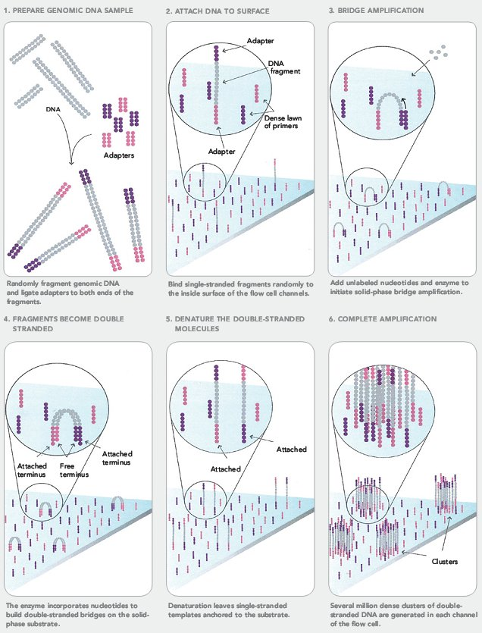
Cluster Formation on Illumina Flowcell

Slide 10
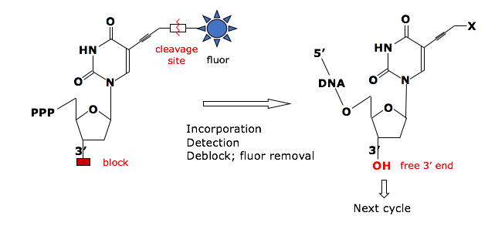
Sequencing by Synthesis
Reversible Terminator Chemistry
3’-
…-5’
5’-
G
T
A
T
T
T
T
C
G
G
C
A
C
A
G
A
G
A
C
T
T
C
T
G
Cycle 1: Add sequencing reagents
First base incorporated
Remove unincorporated bases
Detect signal
Cycle 2-n: Add sequencing reagents and repeat

Slide 11
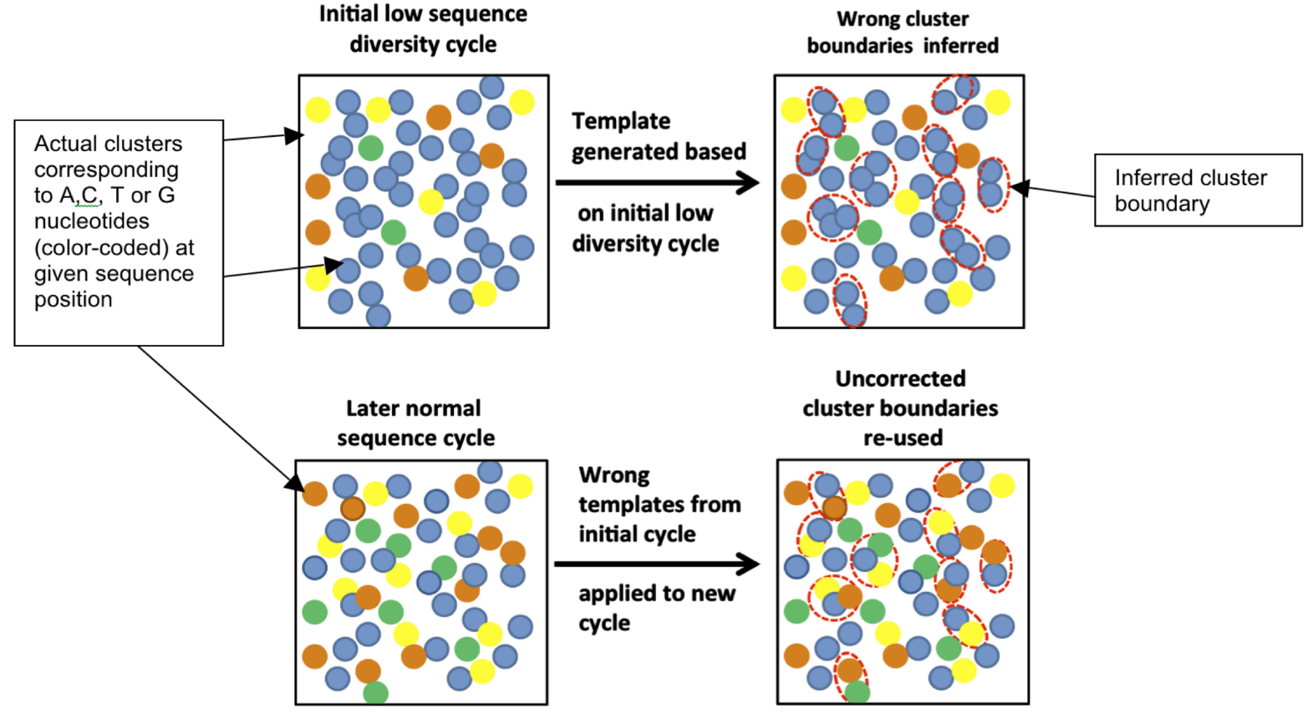
Key considerations
“Cluster Density” = how many clusters are there per mm²
If too high, hard to properly draw cluster boundaries
“Library Complexity” = how diverse are the sequences?
Illumina identifies clusters in the first 5 cycles – if those 5 cycles are identical for nearby clusters, the software doesn’t know to split them into two
Mitra, A. et al. Plos ONE (2015)
Notes:
How can you solve a problem like this?
Decrease cluster density – works, but lose sequencing power
Artificially add complexity
Spike in other libraries
Add random-mers

Slide 12
HiSeq 4000
Patterned flow cell with nanowells
Only 1 cluster per nanowell
Explicitly defines cluster density
Increased throughput:
400 million reads per lane x 8 lanes

Slide 13
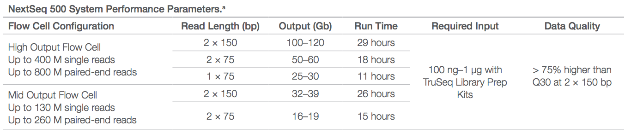
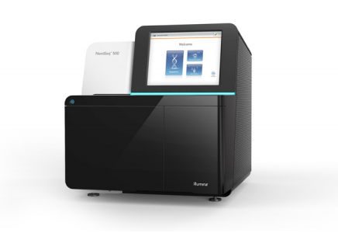
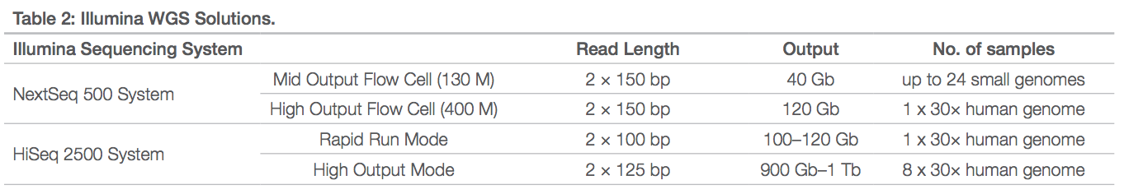
Nextseq 500
Faster, cheaper means of collecting high coverage NGS data
WGS, exome sequencing, RNA-seq
Less capacity than HiSeq technologies

Slide 14
Illumina sequencing – fragment strategy
I5 adapter
Read1 primer
DNA insert (your library)
Read2* primer
I7 adapter
Flow Cell Surface
I5 index*
I7 index*
* optional
Reaction #
Flow Cell Surface
1
Read1 primer
Read1 sequence
Flow Cell Surface
2*
Index1 primer
Index1 sequence

Slide 15
Illumina sequencing – Paired End & Dual Indexing
Reaction #
Flow Cell Surface
1
Read1 primer
Read1 sequence
Flow Cell Surface
2*
Index1 primer
Index1
(I7) sequence
Flow Cell Surface
3*
Index2 primer
Index2
(I5) sequence
Flow Cell Surface
4*
Read2 primer
Read2
sequence
* optional

Slide 16
Paired-end sequencing results in more accurate sequence alignment

Slide 17
RNA-Seq Analysis Overview:
Download Data
(fastq)
Check Quality (fastqc)
Align to Genome (STAR)
Sort and Index BAM (samtools)
Count Reads Mapped to Genes (featureCounts)
Differential Expression (DESeq2)
Interesting Biology!

Slide 18
Fastq File
First line is the information about the location of the read and specific sequencing machine used:
Second line is the nucleotide sequence called
Third line is “+” and can optionally be followed by a repeat of the filename in line 1
Fourth line contains the quality score as determined by the sequencer
@NS500672:54:HL775BGXX:1:11101:22716:1042 1:N:0:CCCCGG
CCGCCNATGCCCATGCCACAGTTGTTGAGCTTGAGTTCCTGCAGGGTGAAGCAGGCTGAGCTCTTGAGCAGGGCCTCGAA
+
AAAAA#EEEEEEEEEEEEEEEEEEEEEEEEEEEEEEEEEEEEEEEEEEEEEEEEEAEEEEEEEEEEEEEEEEEEEEEEEE
Notes:
Four lines represent 1 read off the machine

Slide 19
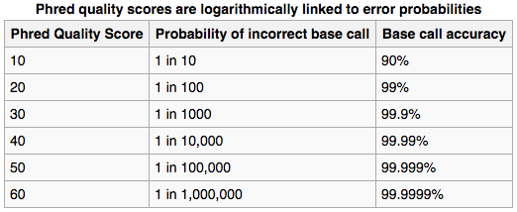
Fastq File – Phred Quality Score
Quality scores report the probability that the base call is incorrect
Field standard is to accept bases with quality >20
Notes:
Four lines represent 1 read off the machine
Quality scores have been converted into the ascii code for reporting… not important here

Slide 20
Illumina sequencing – great for read #, not great for read length
Quality score
0
100
200
300
400
Cycle #

Slide 21
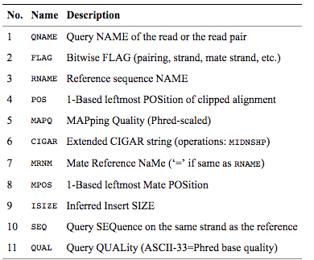
SAM/BAM File
BAM files are binary, you must use samtools to view them
Bioinformatics. 2009 Aug 15;25(16):2078-9. Epub 2009 Jun 8. The Sequence Alignment/Map format and SAMtools.
Notes:
Four lines represent 1 read off the machine

Slide 22
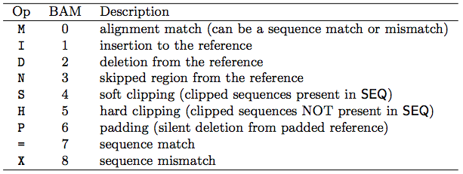
Concise Idiosyncratic Gapped Alignment Report (CIGAR) String
Contains specific information about the mapping information at specific positions across the read
Bioinformatics. 2009 Aug 15;25(16):2078-9. Epub 2009 Jun 8. The Sequence Alignment/Map format and SAMtools.

Slide 23
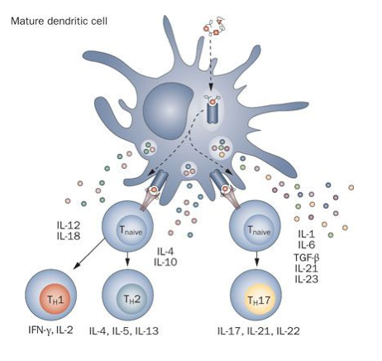
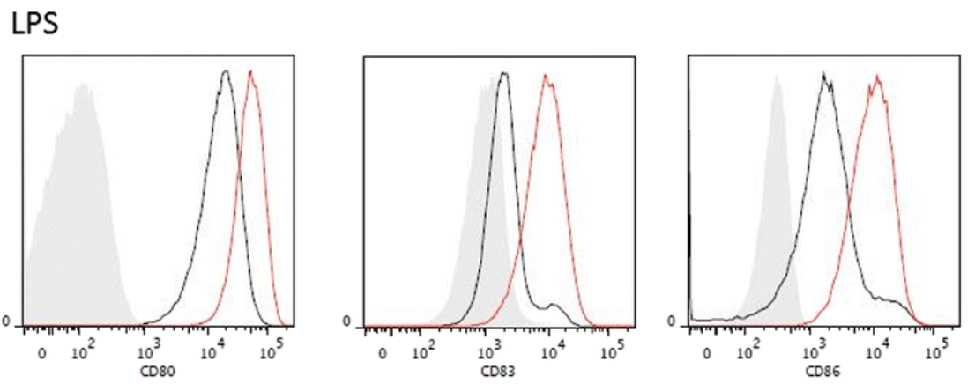
Dataset: Primary dendritic cells following exotoxin activation
Dendritic cells: antigen-presenting cells
Phagocytose pieces of pathogens in surrounding environment
Immature: sample pathogens and degrade proteins into presentable peptides
Mature: localize to lymph nodes and activate T cells through antigen presentation
Exposure to bacterial, viral, or fungal pathogen evokes specific transcriptional program through interaction will cell receptors (e.g. TLRs)
Serves as link between innate and adaptive immunity
Goal: look at immune response gene patterns following exposure to pathogen component lipopolysaccharide (LPS) (bacterial stimulation) throughout maturation
Comabella et al., Nature Reviews Neurology 2010
Street et al., Journal of Orthopaedic Surgery and Research 2015
Notes:
The Encyclopedia of DNA Elements (ENCODE) is a public research project launched by the US National Human Genome Research Institute (NHGRI) in September 2003. Intended as a follow-up to the Human Genome Project (Genomic Research), the ENCODE project aims to identify all functional elements in the human genome.

Slide 24
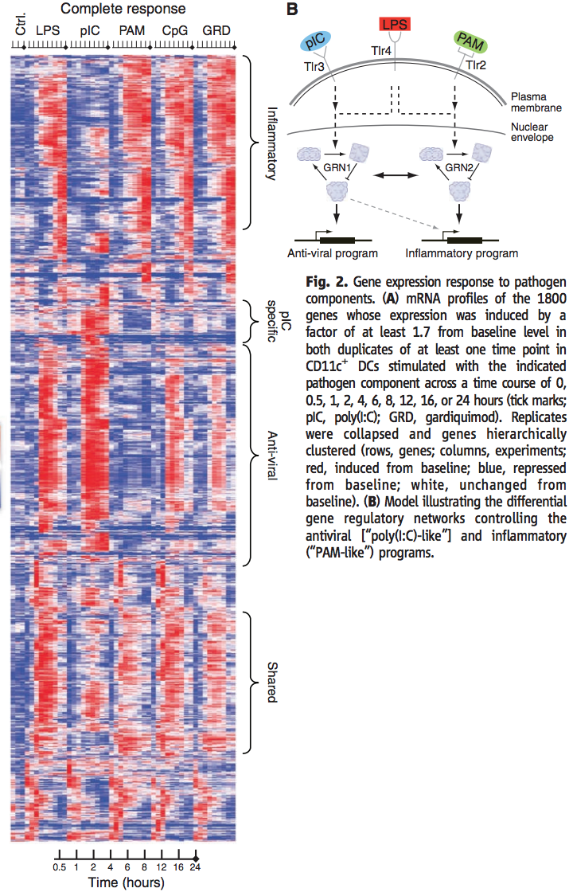
Dataset: Primary dendritic cells following exotoxin activation
Dendritic cells: antigen-presenting cells
Phagocytose pieces of pathogens in surrounding environment
Immature: sample pathogens and degrade proteins into presentable peptides
Mature: localize to lymph nodes and activate T cells through antigen presentation
Exposure to bacterial, viral, or fungal pathogen evokes specific transcriptional program through interaction will cell receptors (e.g. TLRs)
Serves as link between innate and adaptive immunity
Goal: look at immune response gene patterns following exposure to pathogen component lipopolysaccharide (LPS) (bacterial stimulation) throughout maturation
Amit et al., Science 2009
Notes:
The Encyclopedia of DNA Elements (ENCODE) is a public research project launched by the US National Human Genome Research Institute (NHGRI) in September 2003. Intended as a follow-up to the Human Genome Project (Genomic Research), the ENCODE project aims to identify all functional elements in the human genome.

Slide 25

Dataset: Primary dendritic cells following exotoxin activation
Samples: bone marrow-derived dendritic cells (differentiated in vitro from mouse bone marrow)
Exposed to 100 ng/ml LPS for 0 to hours
4-hour time point: cells characterized to have pronounced migratory ability and poor antigen uptake ability
Compare initial and long-term/terminal gene signatures of maturing DCs
https://www.encodeproject.org/rna-seq/long-rnas/
Each replicate should have 30 million aligned reads, although older projects aimed for 20 million reads.
Replicate concordance: the gene level quantification should have a Spearman correlation of >0.9 between isogenic replicates and >0.8 between anisogenic replicates (i.e. replicates from different donors).
Notes:
The Encyclopedia of DNA Elements (ENCODE) is a public research project launched by the US National Human Genome Research Institute (NHGRI) in September 2003. Intended as a follow-up to the Human Genome Project (Genomic Research), the ENCODE project aims to identify all functional elements in the human genome.

Slide 26
RNA-Seq Analysis Overview:
Download Data
(fastq)
Check Quality (fastqc)
Align to Genome (STAR)
Sort and Index BAM (samtools)
Count Reads Mapped to Genes (featureCounts)
Differential Expression (DESeq2)
Interesting Biology!

Slide 27
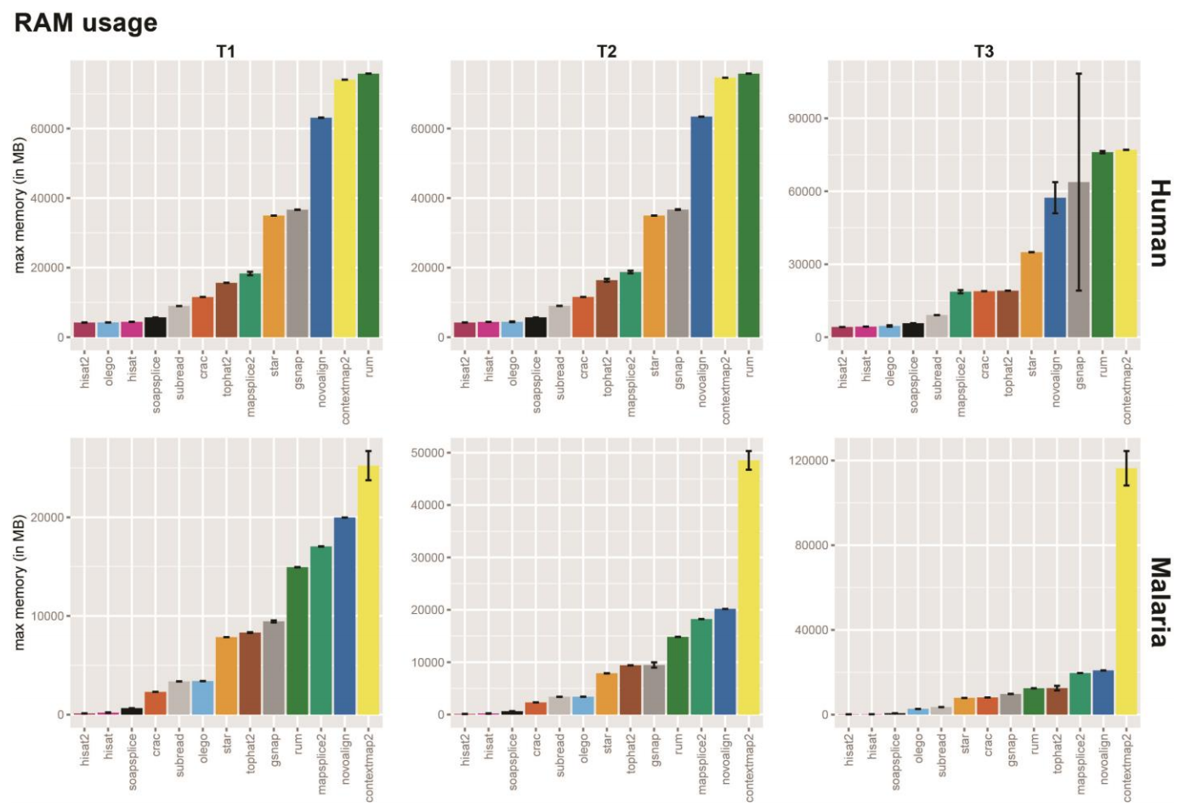
Different sequence aligners
Run time
Exon junction aligner comparison
Baruzzo et al. Nature Methods 2017

